Slide 1
World Cup’s Best Player Prediction
Vivek Nimmagadda – 15B00288

Slide 2
Main Components
Player Prediction Application
Phase 1 – UiPath (Data Scraping)
Phase 2 – Machine Learning (Player and Match Outcome Prediction)
Phase 3 – Python (Visualization)

Slide 3
Data Scraping
Used UiPath tool to scrap data of various players.
Various activities present in UiPath were used according to the requirements.
Scraped data is carefully stored inside a CSV for performing Machine Learning Algorithms.

Slide 4
Player Prediction Application
Made basic GUI and functionalities using python libraries and Tkinter.
Buttons present at the bottom calls their respective functions whenever clicked.
Canvas at the top consists of various plots used in the application.

Slide 5
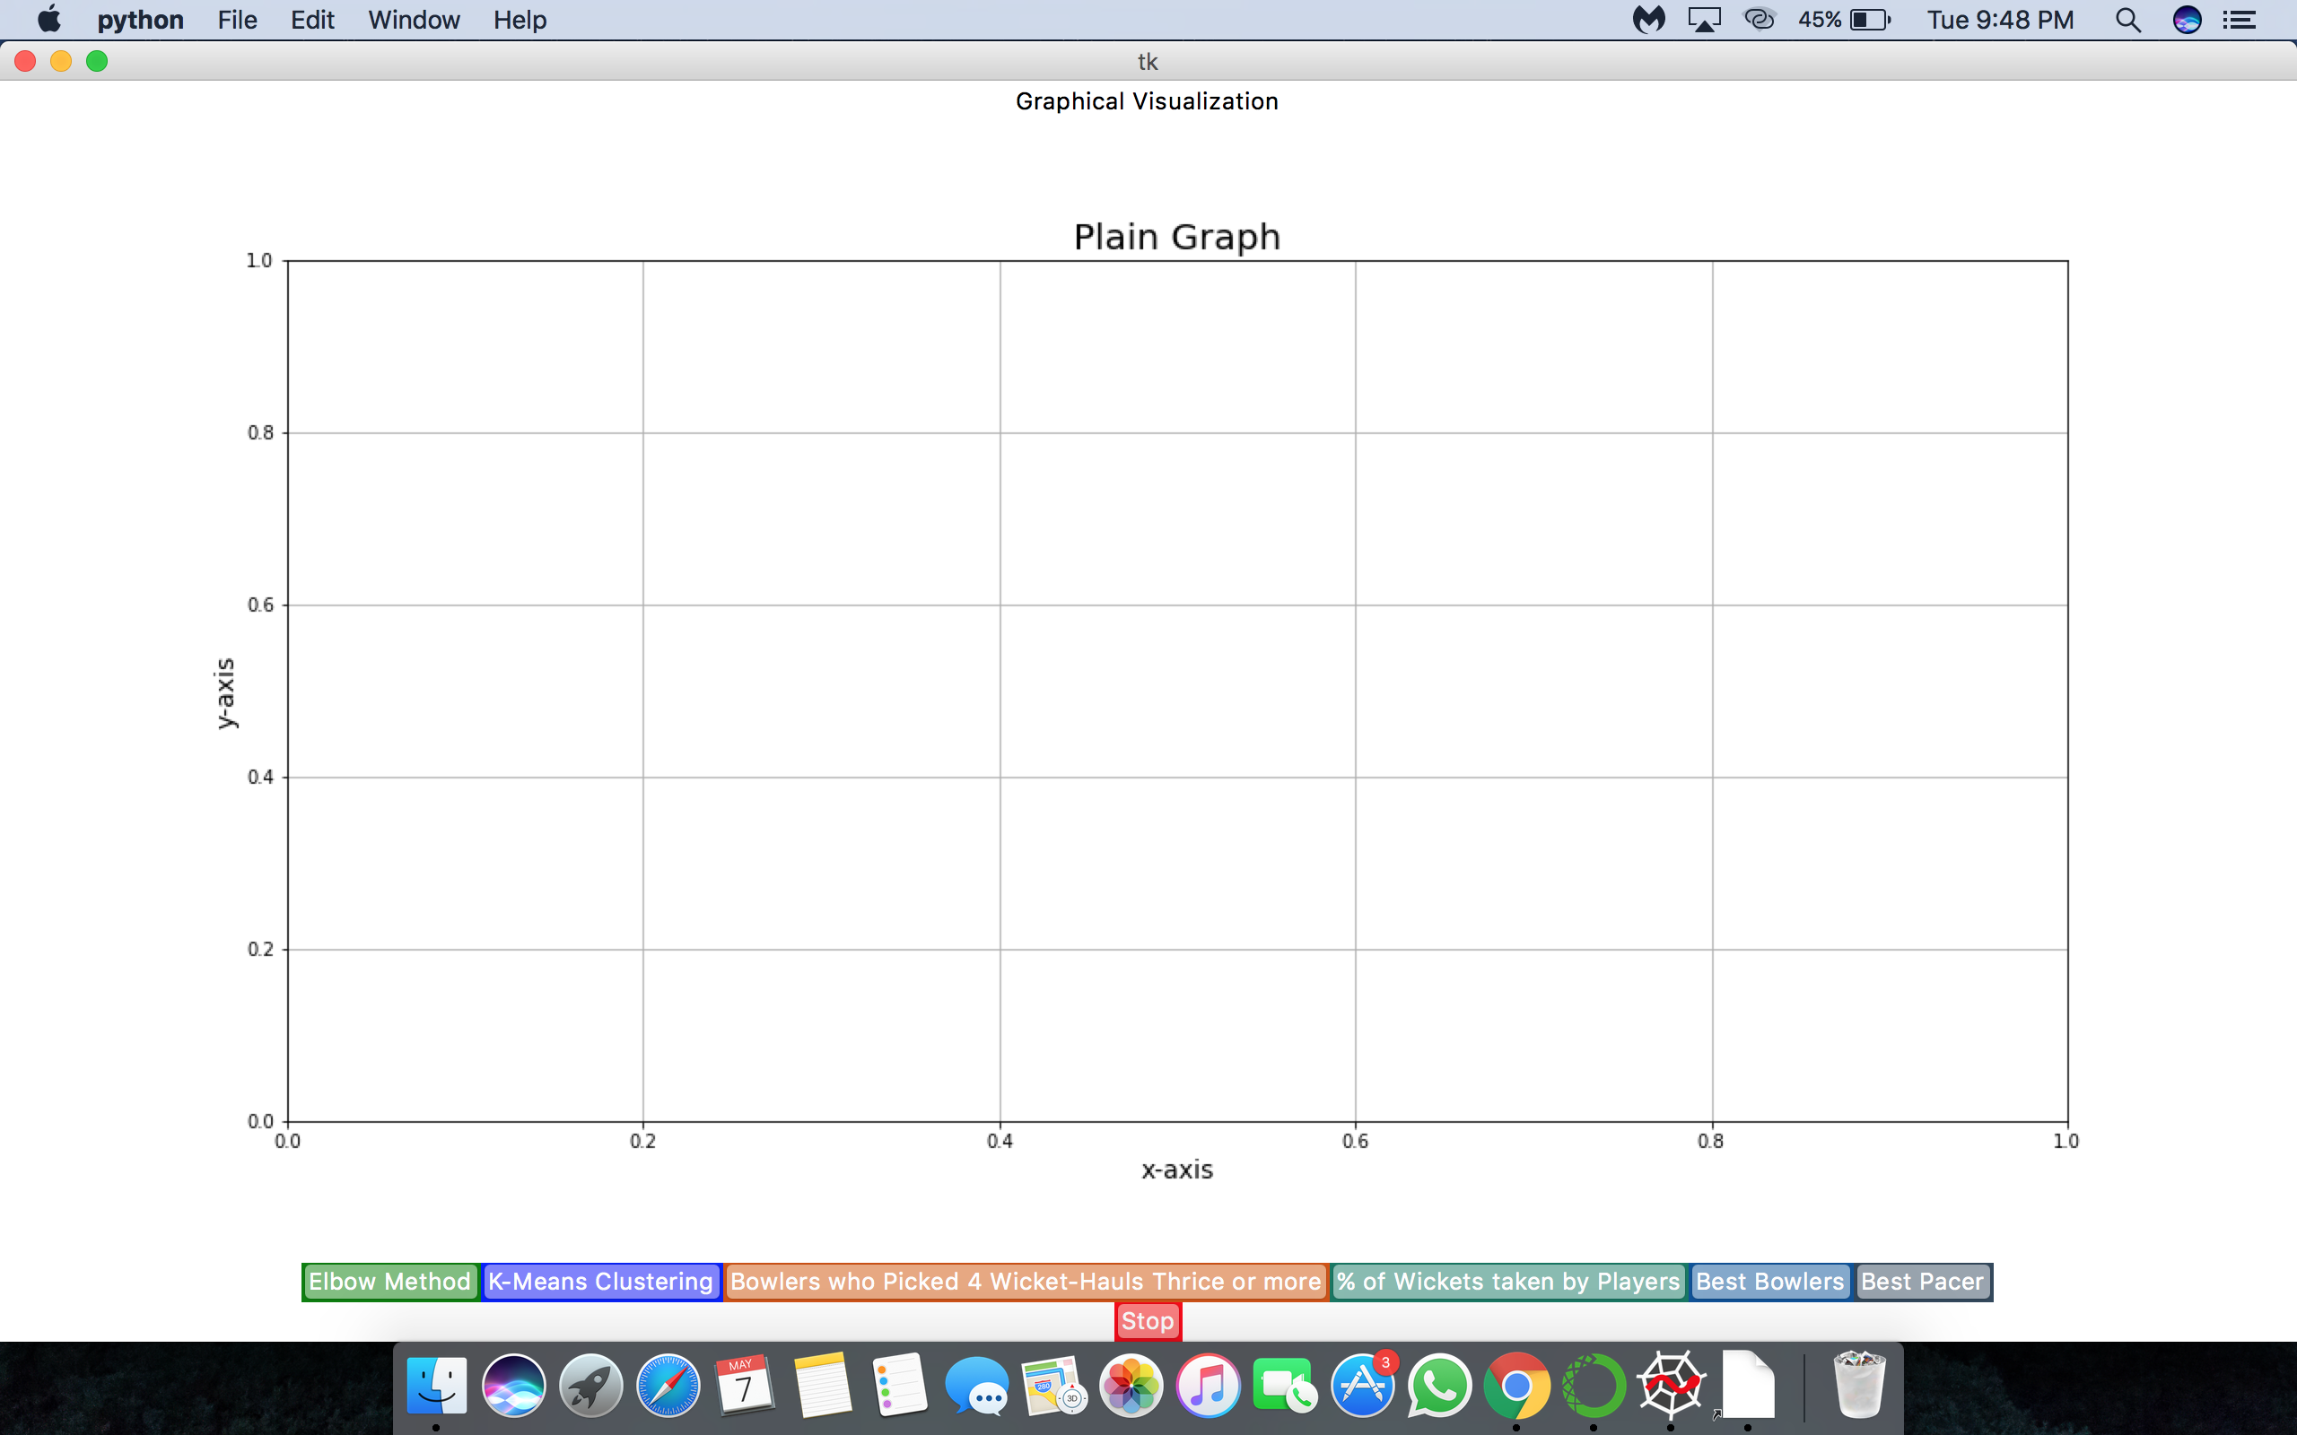

Slide 6
Machine Learning
Divided players into 4 categories using K-Means Clustering technique.
Found the optimal number of clusters using Elbow-Method.
Several Classification techniques were used to predict the match results.
Decision Trees fits the data better with an accuracy of 63.8%.

Slide 7
Challenges
Data Availability and Quality.
Scraping the Data.
Understanding of Prediction Boundaries.
Visualizing the Plots.

Slide 8
Why Player Prediction?
Formulating match strategies, tactics and player analysis.
Player acquisition and validation at the start and end of a tournament, team spending.
Helps to focus on weak areas of the players.
Predicting and preventing injury concerns by varying workloads.
Match and League outcome predictions.
Odds calculation for professional betting and many more.

Slide 9
Future Scope
Improved data.
Using more powerful classification model.
GUI Enhancements.
Additional Functionalities.

